Slide 1
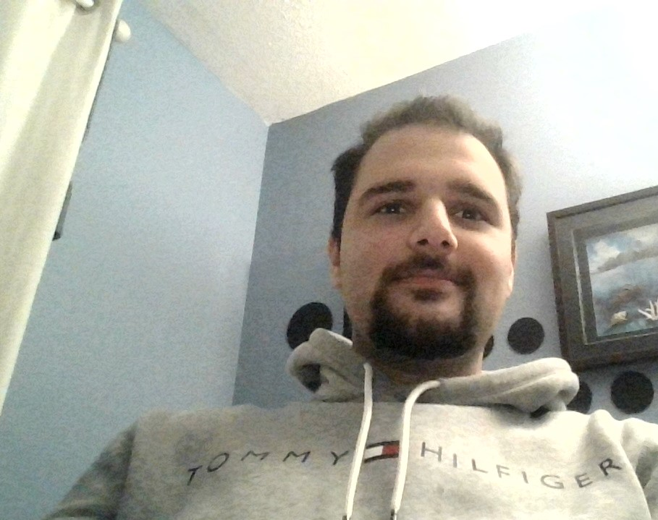
Assignment 1
Farhan Irani 100748418
Intermediate Graphics INFR-2350U

